Slide 1

ISTANBUL TECHNICAL UNIVERSITY
Faculty of Computer and InformatIcs
Computer EngIneerIng DepartmenT
Introduction to Bioinformatics
Term Project
Aybike Zeynep Taskin
150190004
Bilal Ihsan Tuncer
150190089

Slide 2
Introduction
Aim of the project:
Comparison of the performance of different next generation sequencing (NGS) data processing algorithms using CoSAP (Comparative Sequencing Analysis Platform).
Tools:
Windows Subsystem for Linux
ASUS ROG laptop with 16GB RAM, Intel i5
CoSAP

Slide 3
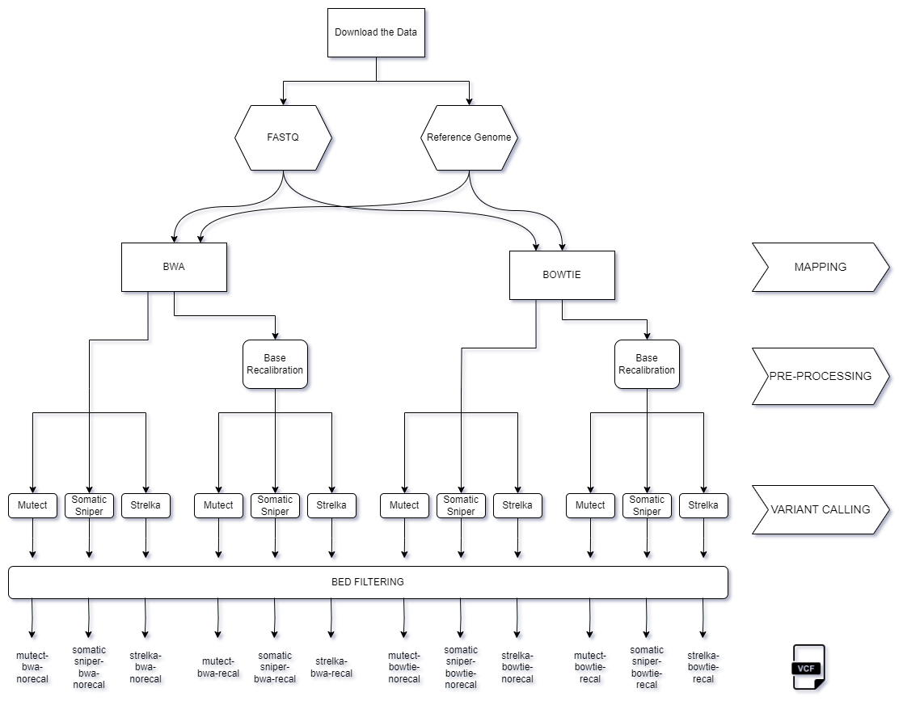
Flowchart
of our
project

Slide 4
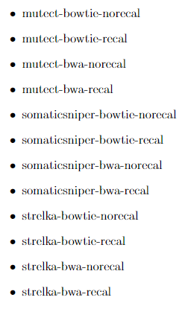
Output VCF files
1) Raw sequencing data in FASTQ format
2) Mapping to a reference genome with BWA or Bowtie, generating BAM files.
3) Pre-processing, recalibration (optionally)
4) BAM files used for variant calling with tools (Mutect, Strelka and Somatic-Sniper) to produce VCF files
5) BED filtering and snpfilter for Somatic-Sniper
(2 base-recalibration options x 2 mappers x 3 variant callers)

Slide 5
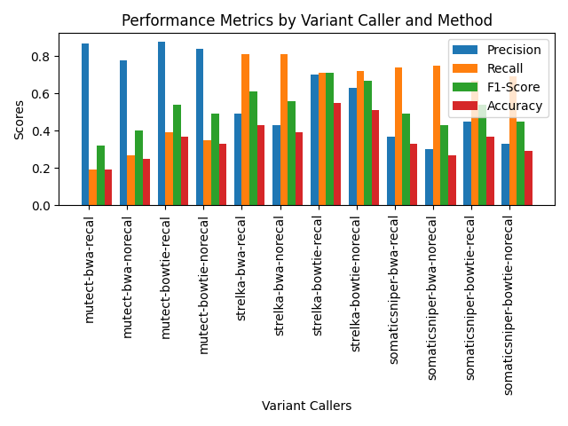
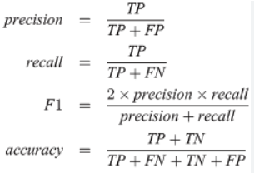
Performance Metrics
Performance Metrics

Slide 6
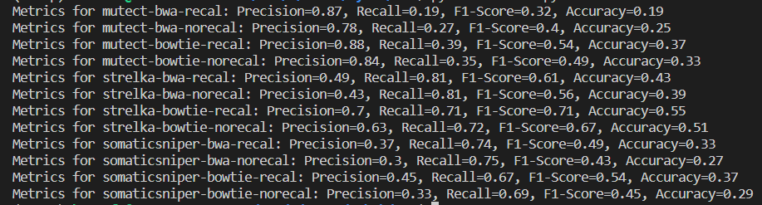
Performance Metrics
Paragraf metniniz
Precision, Recall, F1-score, Accuray values of the VCF outputs

Slide 7
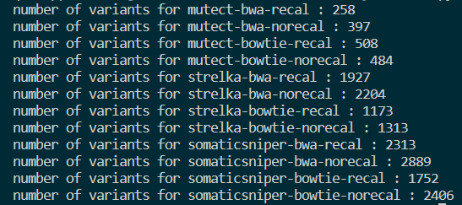
Number of Variants
Paragraf metniniz

Slide 8
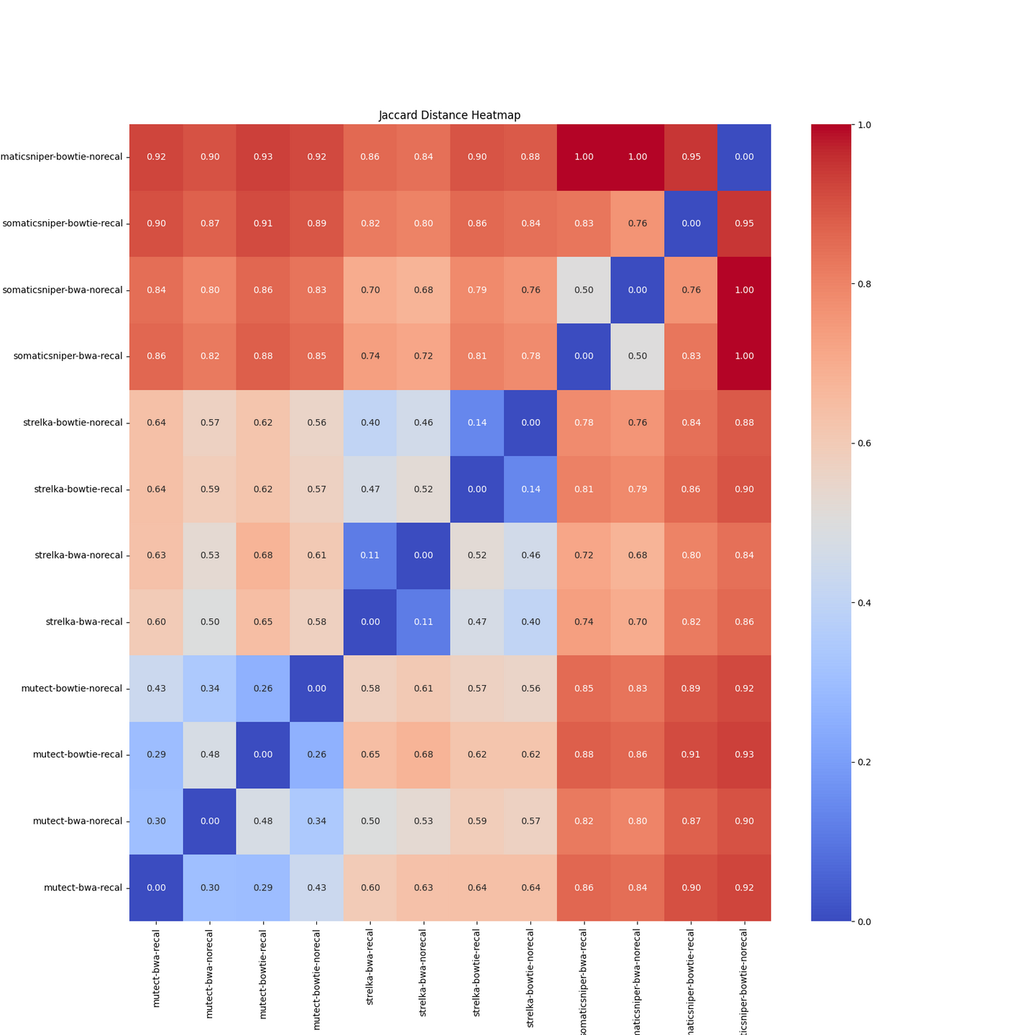

Heatmap
Visualization of similarities of VCF outputs using Jaccard Distance
Jaccard Distance Formula :

Slide 9
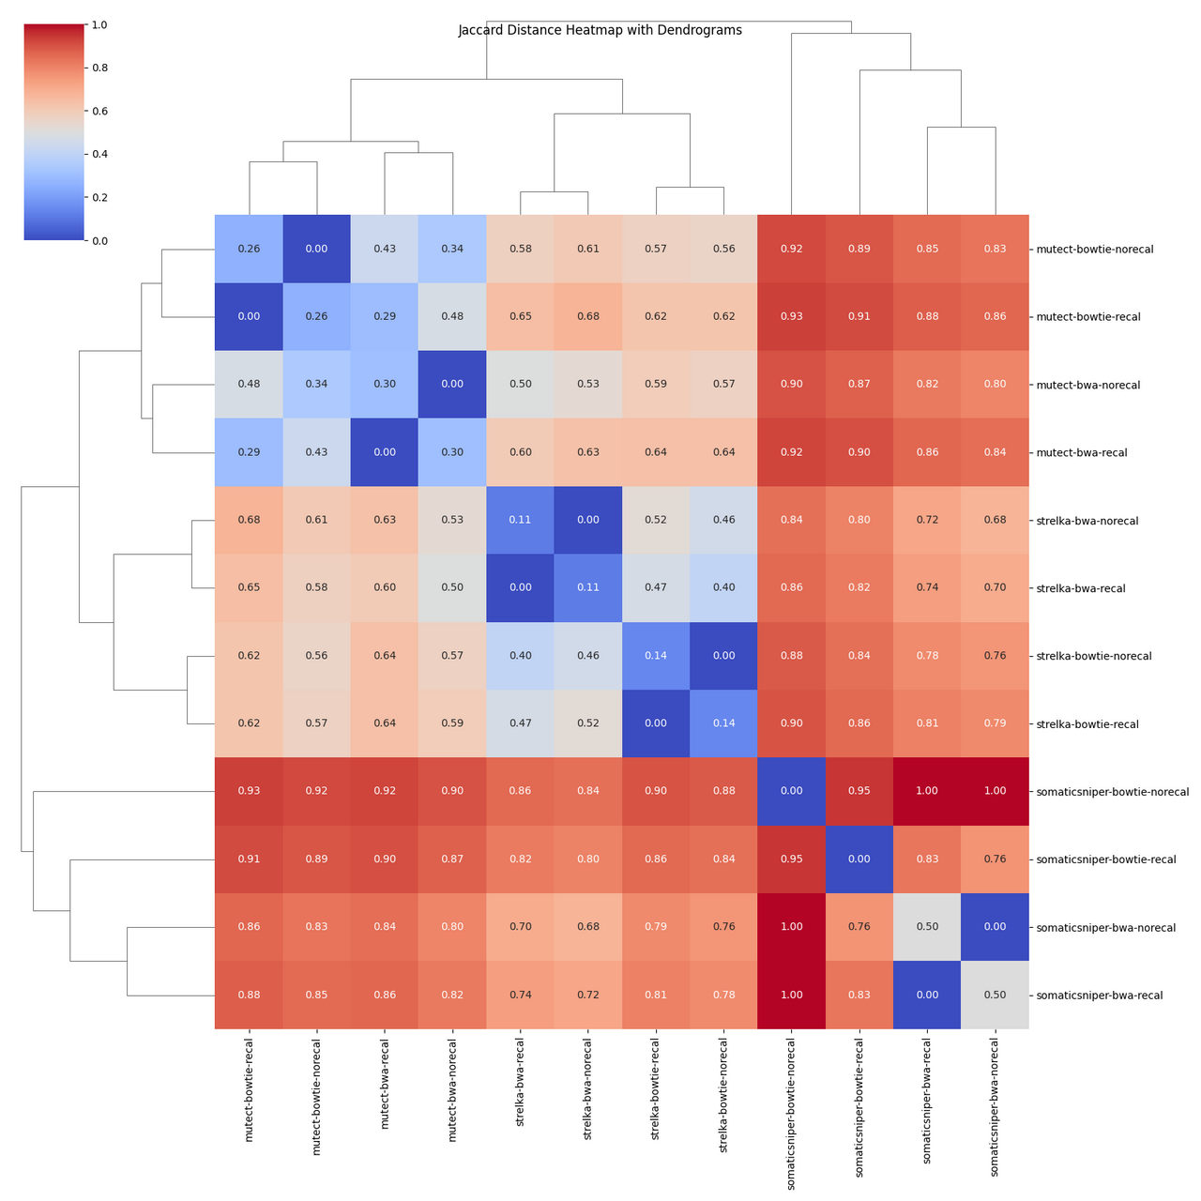
Heatmap
with
Dendogram
Dendogram shows hierarchical relationships between VCF files

Slide 10
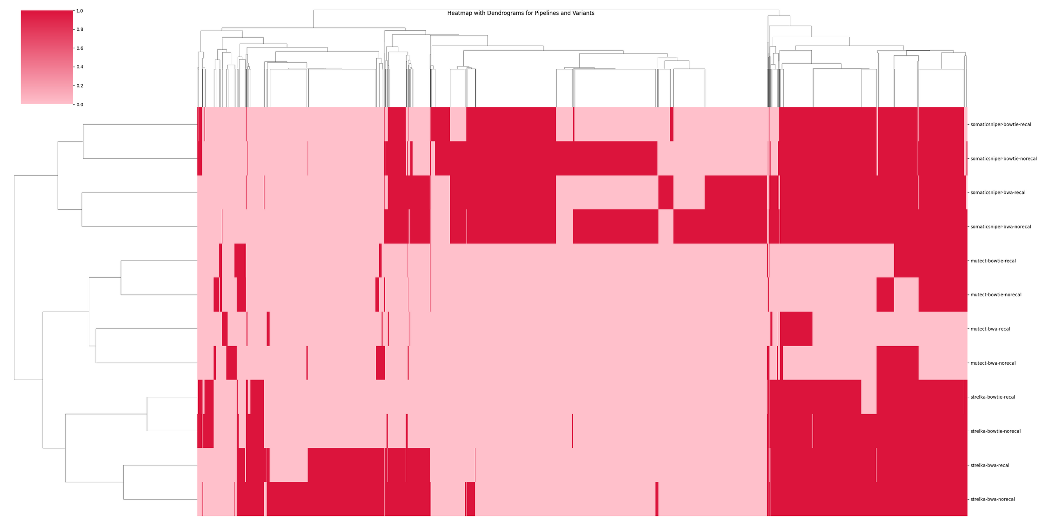
Heatmap for Variants and Pipelines

Slide 11
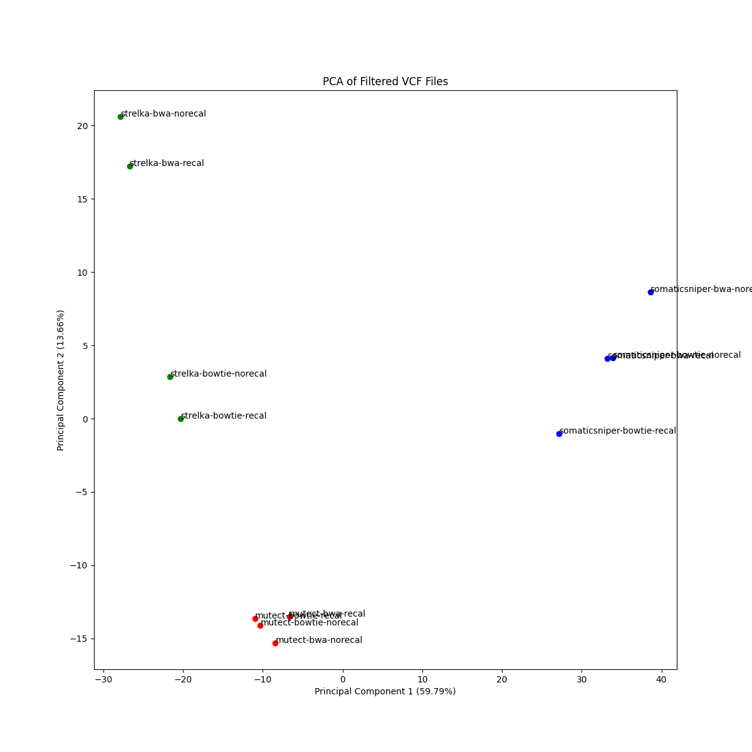
PCA-2D
PCA plottings
Using two principal components

Slide 12
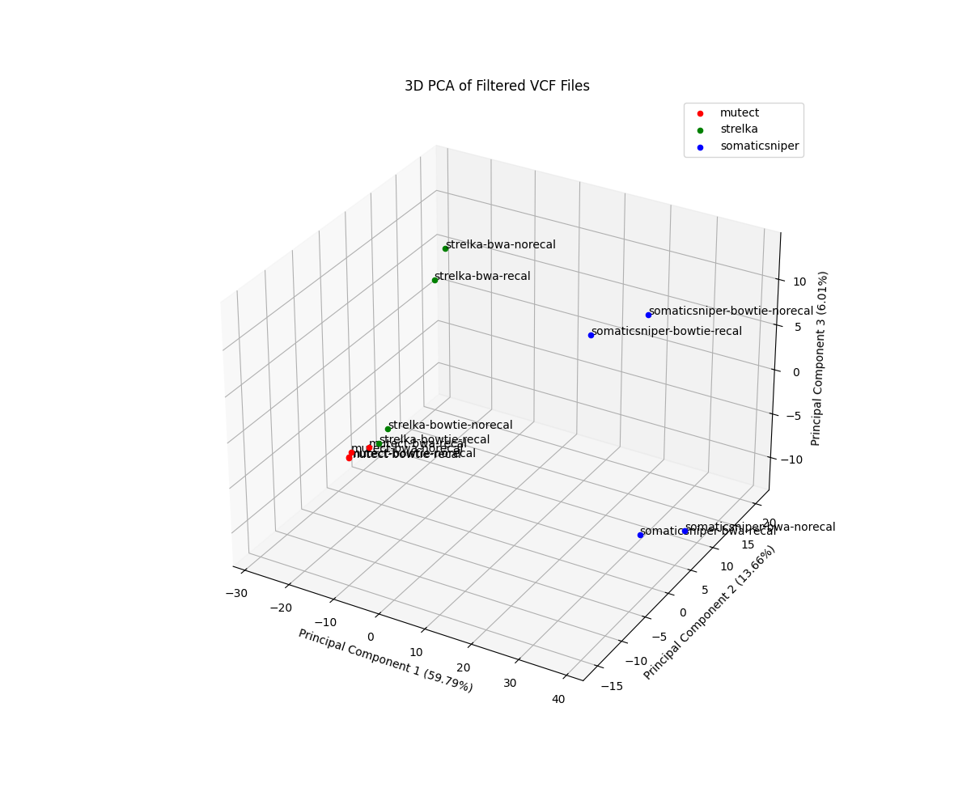
PCA-3D
Using three principal components
PCA plottings

Slide 13
Thank you for listening

